Slide 1

Bright Smiles, Healthy Futures:
Empowering Our Community Through Accessible Dental Care

Slide 2
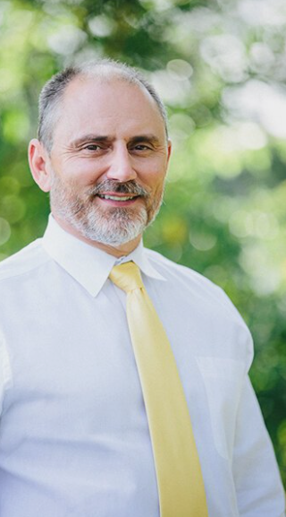
Scottie R. Miller, D.D.S.
VCU School of Dentistry 1995
Certificate of Prosthodontics
VCU School of Dentistry 1997
Co-Director: Denture Team
VDAF Missions of Mercy
Private Practice 1997 - Present
Member ACP, ICOP, ADA, VDA, Southeastern Academy of Prosthodontics and ICD
Board Member: Mission Dental Virginia, Johnston Memorial Hospital Foundation, Virginia Dental Association Foundation, Resident Support Services
Site Director- JMH AEGD Residency Abingdon, VA

Slide 3
MISSION STATEMENT
To provide effective and affordable oral health care to underserved and uninsured individuals and families in Southwest Virginia

Slide 4
WHO WE SERVE
Appalachian Highlands Community Dental Center (AHCDC) is a 501(C)(3) non-profit community dental clinic located in Abingdon, Virginia, to provide oral health care to uninsured and underserved adults and children aged 10+ in Southwest Virginia. Partnered with Ballad Health’s Johnston Memorial Hospital’s Advanced Education in General Dentistry Program, we educate residents, encourage dentists to move to the region, and provide direct care to some of the most vulnerable patients in the nation through Virginia Medicaid and through a sliding fee scale.
Of the 22 residents who have graduated, 6 have stayed in Southwest Virginia and 4 are now AHCDC faculty.

Slide 5
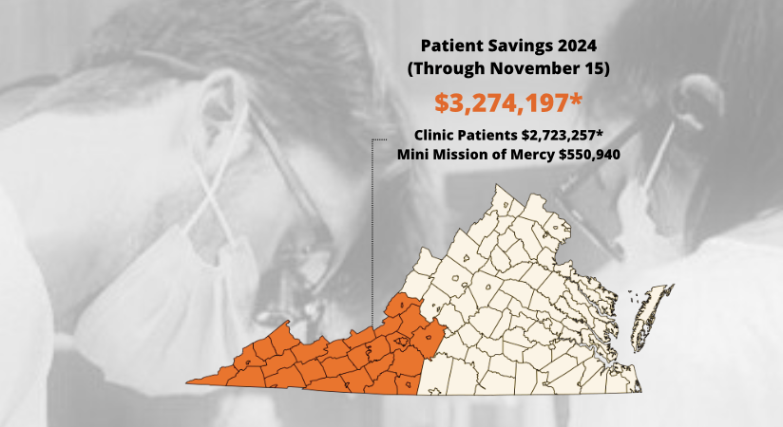
2024 Year In Review
*Data calculated using 2020 ADA Survey of Average Fees

Slide 6
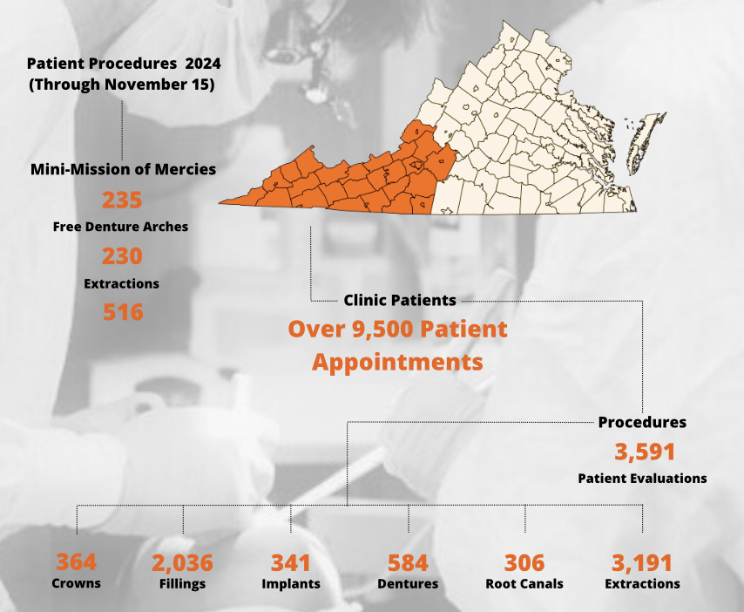


Slide 8
Patient
Demographics:

Slide 9
HOW?
Appalachian Highlands Community Dental Center utilizes Dental Residents from Johnston Memorial Hospital. It is a win-win; providing services to a community, while recruiting dentists from all over the nation from top dental schools to practice in a dental desert, or dental health professional shortage area.
2019-2020 – 1
2020-2021 – 4
2021-2022 – 5
2022-2023 – 5
2023-2024 – 7
2024-2025 – 7
2025-2026 – 8

Slide 10
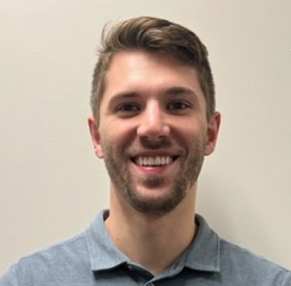
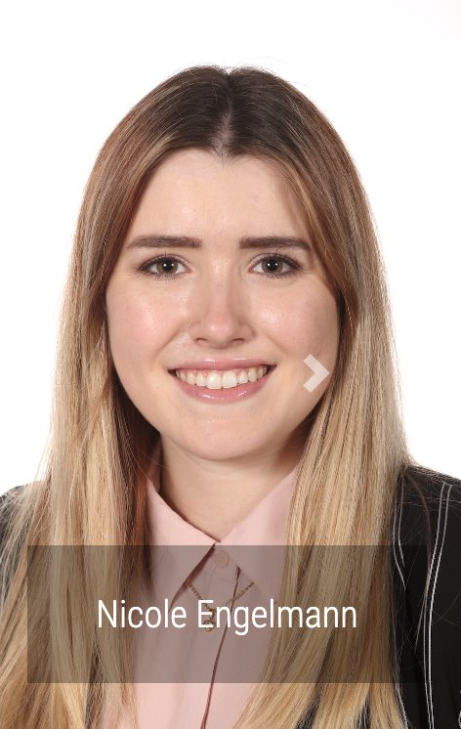
Current 2024 – 2025 RESIDENT CLASS
Hunter Brittain
University of North Carolina
Nicole Englemann
University of Michigan

Slide 11

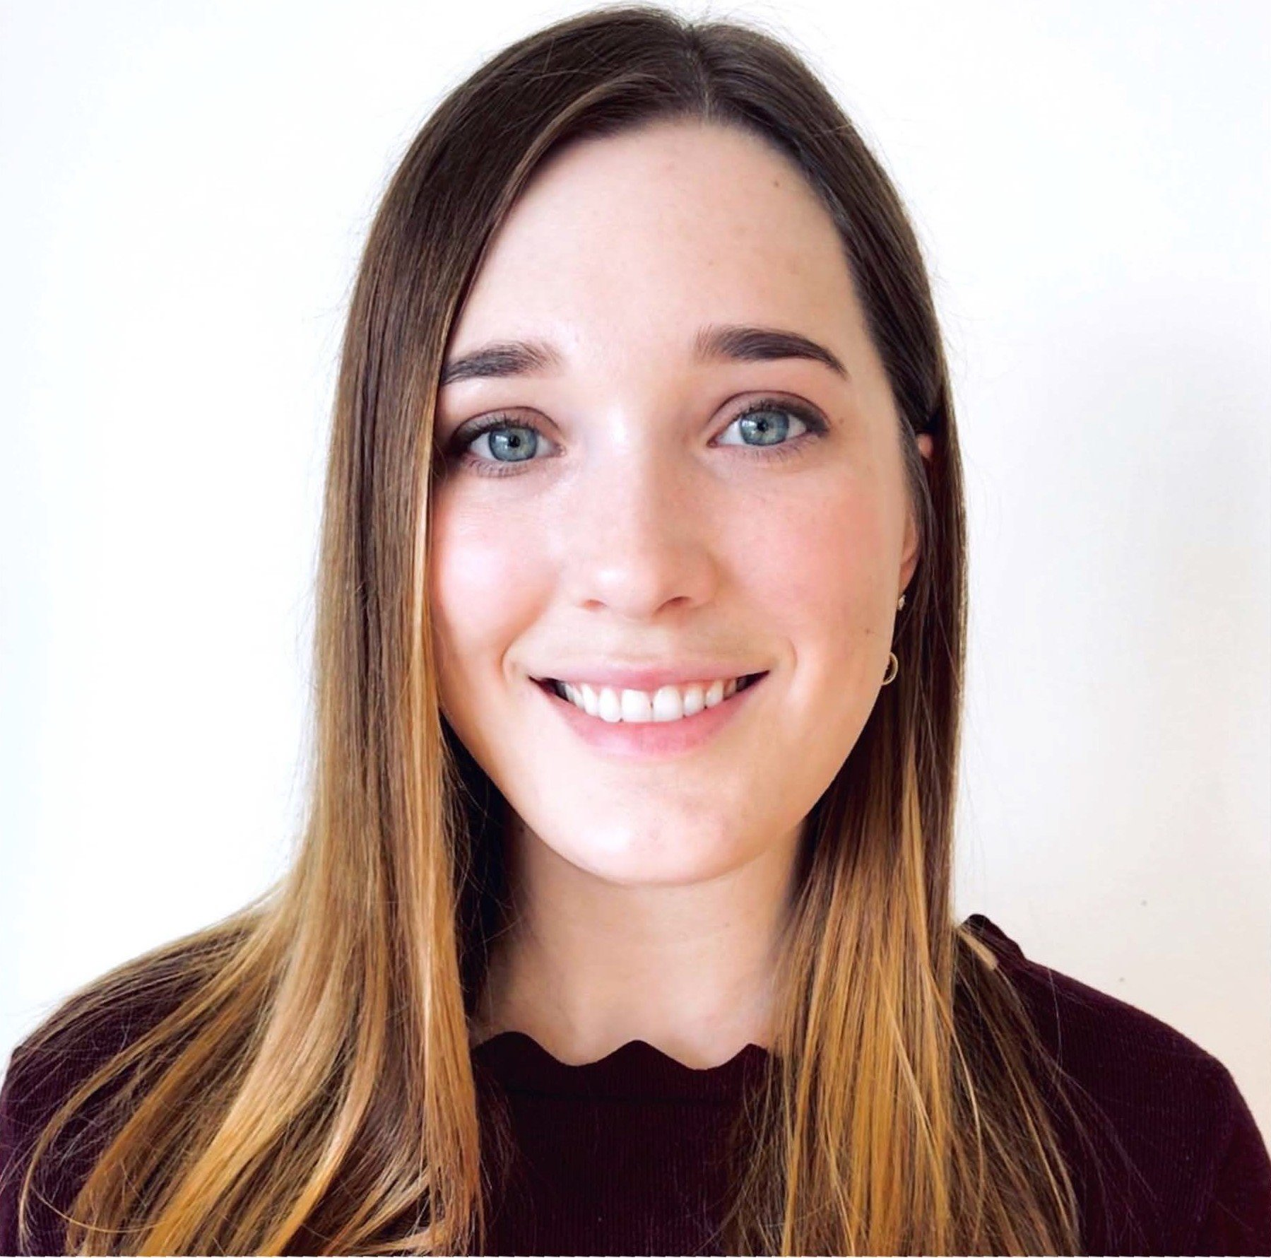
Current 2024 – 2025 RESIDENT CLASS
Michael Guyumdzhyan
University of Washington
Sylvia Howard
University of California – San Francisco

Slide 12
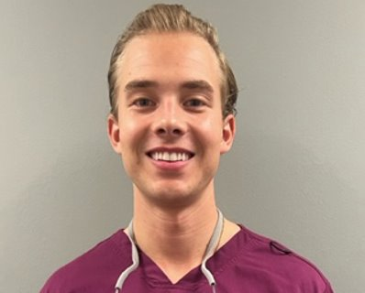
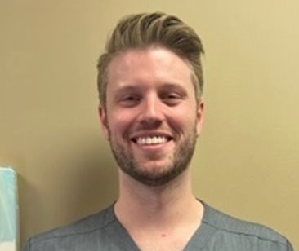
Current 2024 – 2025 RESIDENT CLASS
Jackson “Jack” Madigan
Virginia Commonwealth University
Hunter Smith
University of Tennessee

Slide 13
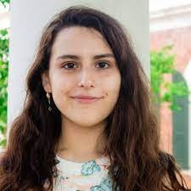
Current 2024 – 2025 RESIDENT CLASS
Michelle Winkler-Mallma
Case Western

Slide 14
KEY DATA
The Appalachian Highlands Community Dental Center Resident Class of 2024 have treated 4,437 patients since July 2024 and completed 11,511 visits
Appalachian Highlands Community Dental Center has seen 32,193 patient visits since inception March 13, 2020 through November 18, 2024
Appalachian Highlands Community Dental Center is welcoming its largest resident class in 2025, with 8 residents

Slide 15
GAINING A FOOTPRINT – OUR RESIDENTS

Slide 16
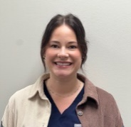
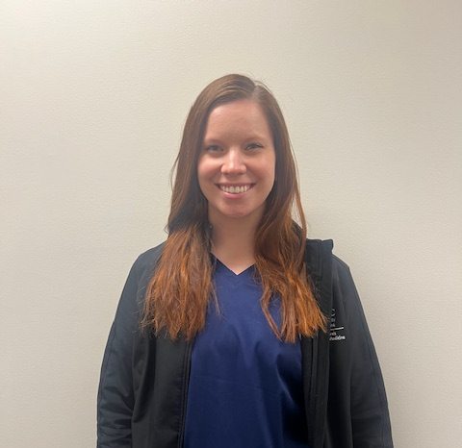
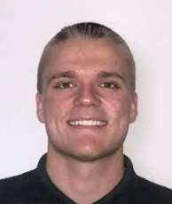
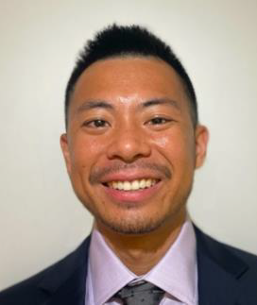
JMH AEGD
Class of 2026
Elaina Fridley – Louisville
Laura Brailsford - MUSC
3. Jarrett. Adkins – VCU
4. Gavin Chen – Harvard

Slide 17

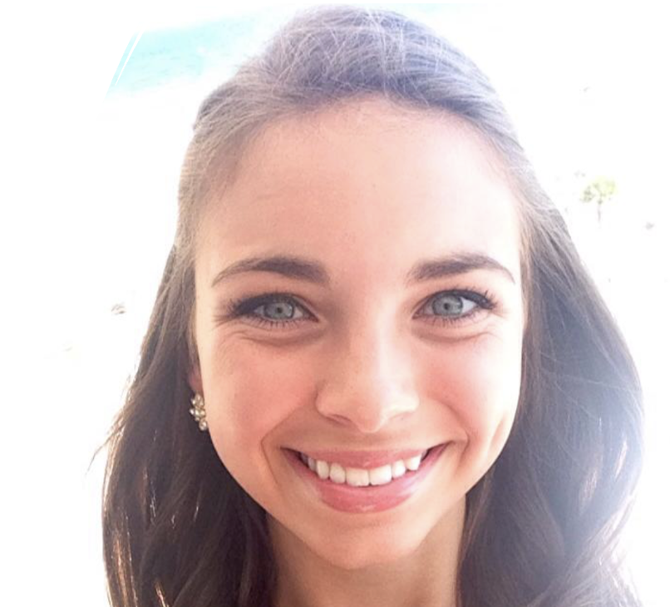
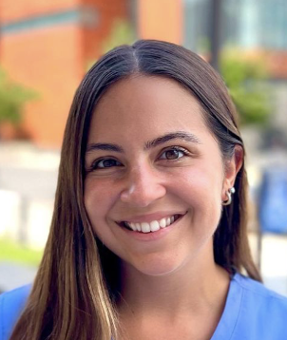
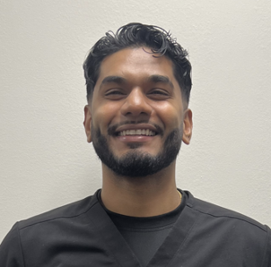
JMH AEGD
Class of 2026
5. Elizabeth Day - Detroit Mercy
6. Kara “Madison” Booth – University of TN
7. Dana Sembera – Howard
8. Brandon Singh - Howard

Slide 18
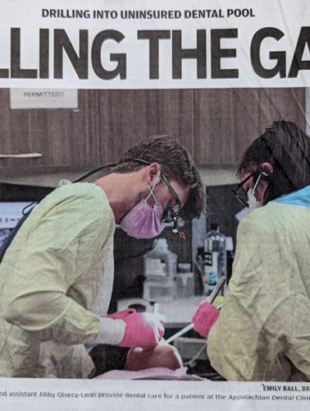
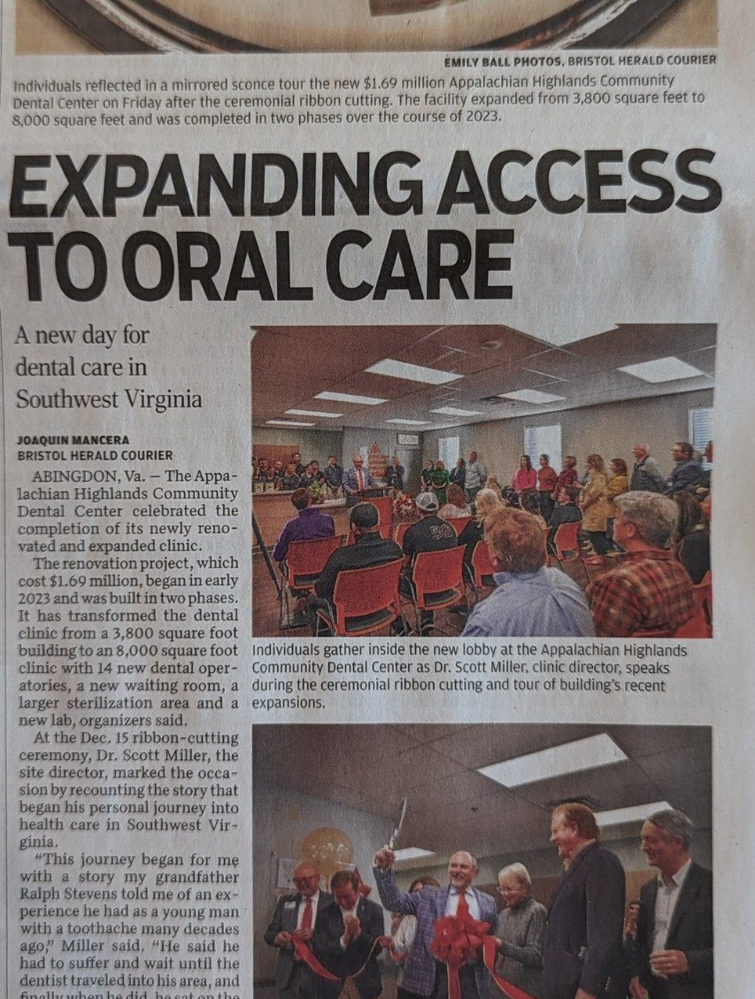
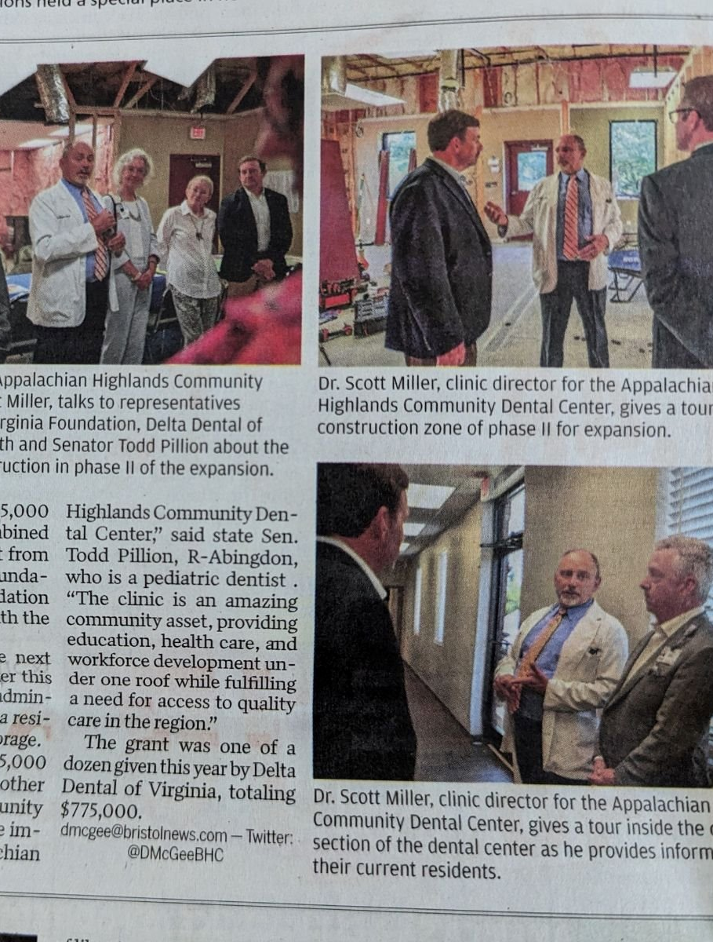
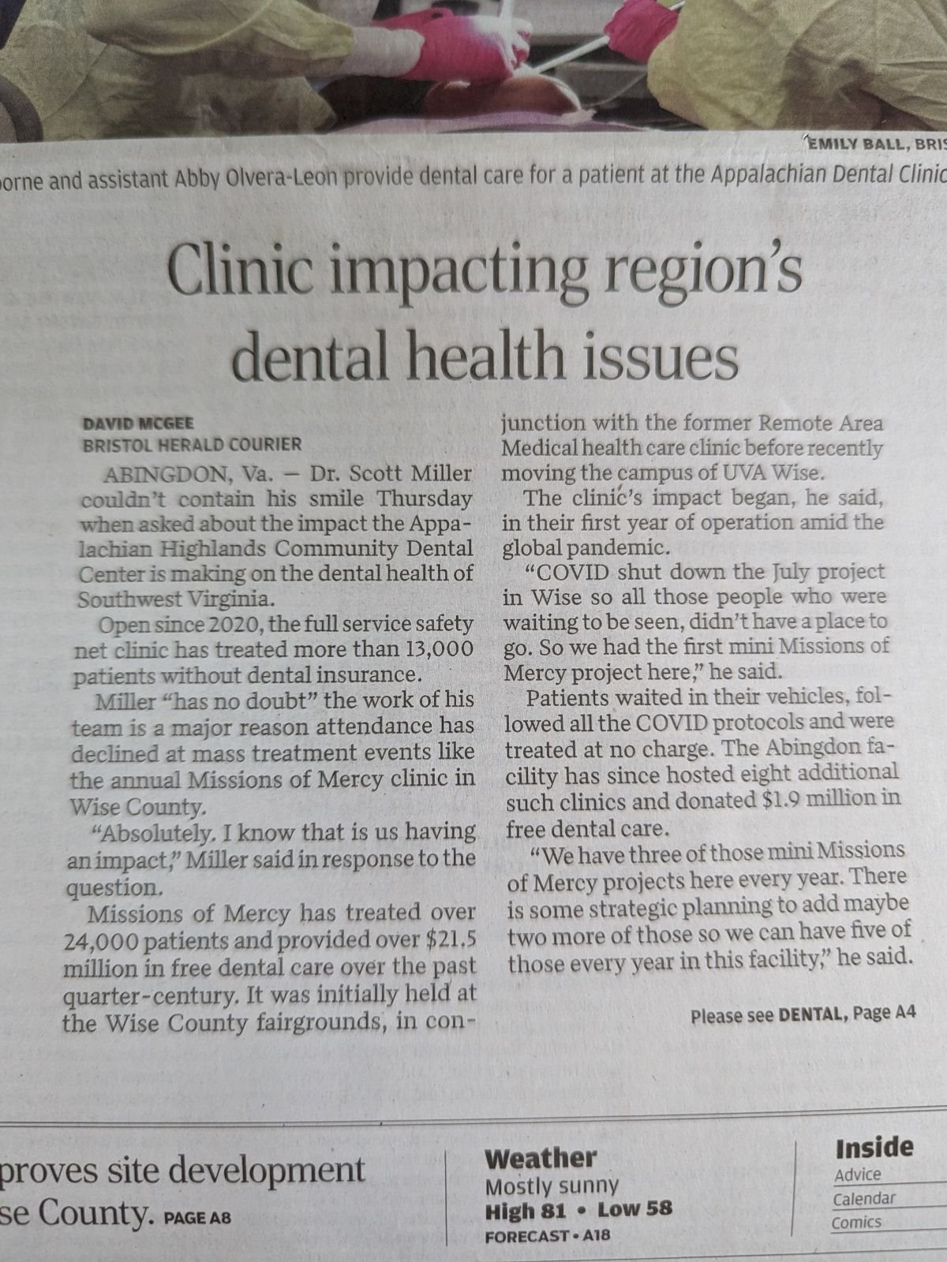
AHCDC - In The News

Slide 19

mini – MOM Projects
Mission of Mercy
3 Projects Annually
  2020 – 2
  2021 – 3
  2022 – 3
  2023 – 3
  2024 – 3
In 2024, three AHCDC hosted mini-MOM events.
14 Total Projects = $2,600,000 in value of care provided to 996 patients.

Slide 20
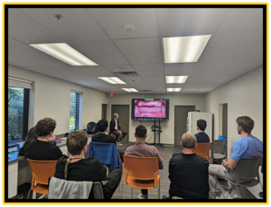
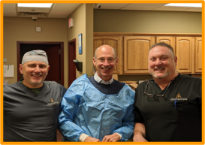
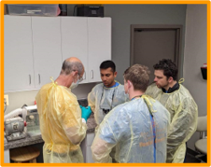
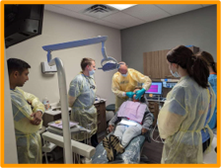
VCU School of Dentistry Dean Lyndon Cooper

Slide 21
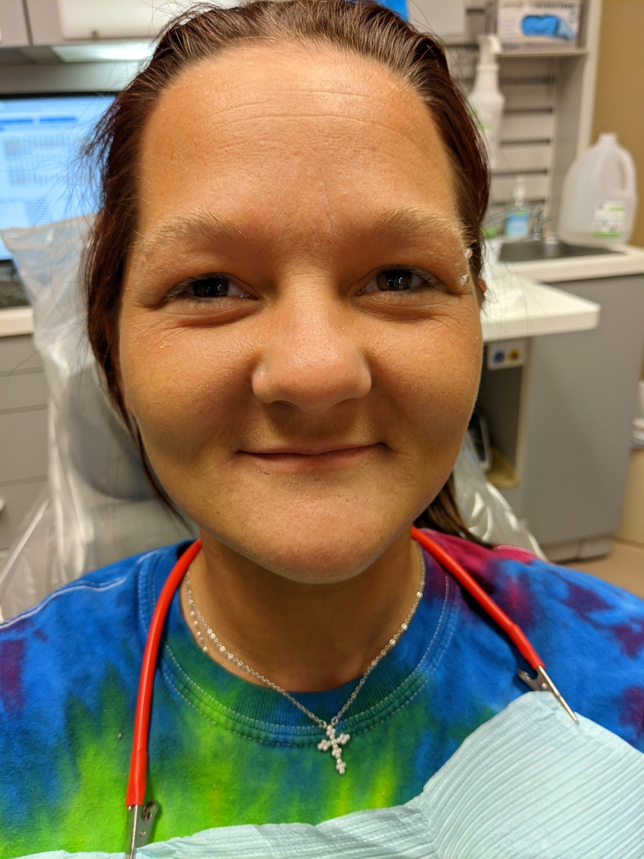
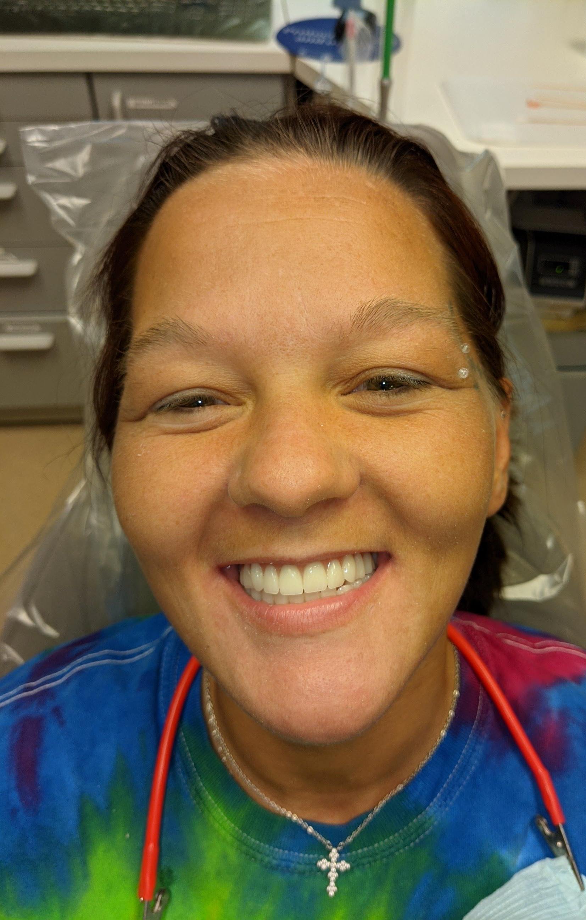
Providing Bright Smiles and Healthy Futures

Slide 22
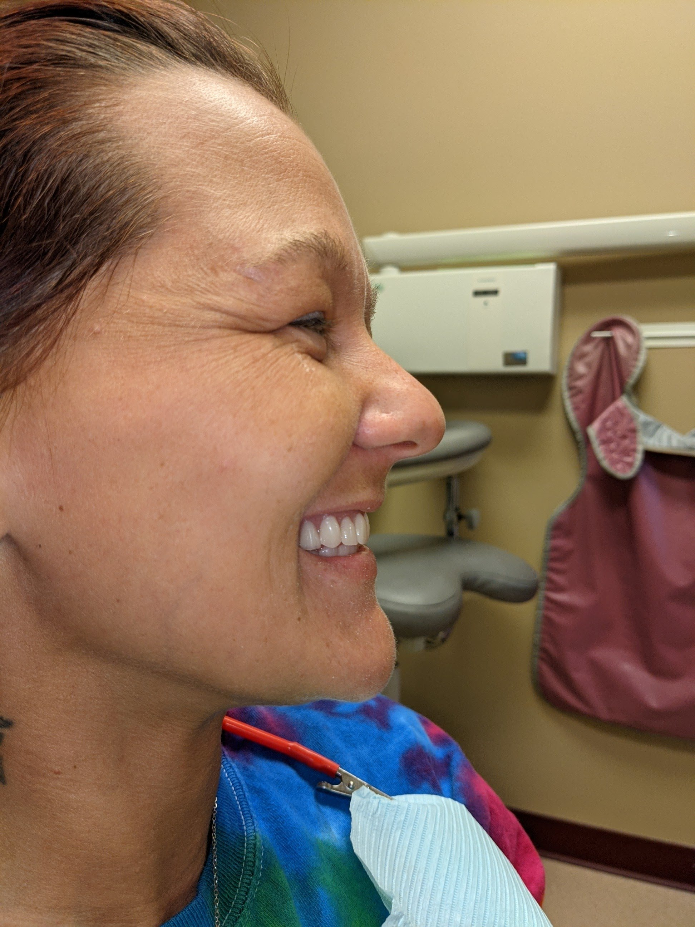
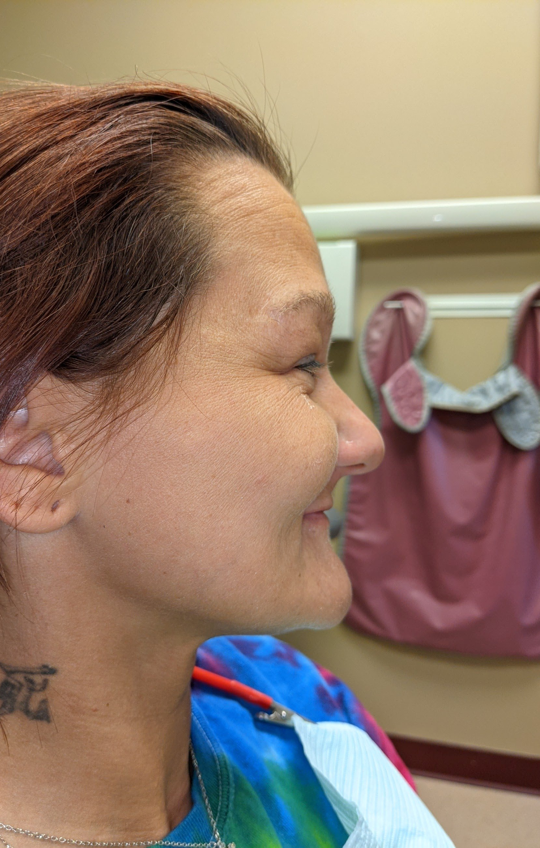
Providing
Bright Smiles and Healthy Futures

Slide 23
Providing Confident Smiles & BETTER HEALTH
Dignity
Better overall health
Nutrition improvement
Improved job placement
Economic development and workforce development – program is a site to home grow dental assistants, dental hygienists, dental lab technicians, and advanced trained dentists in a dental desert and dental health professional shortage area.

Slide 24
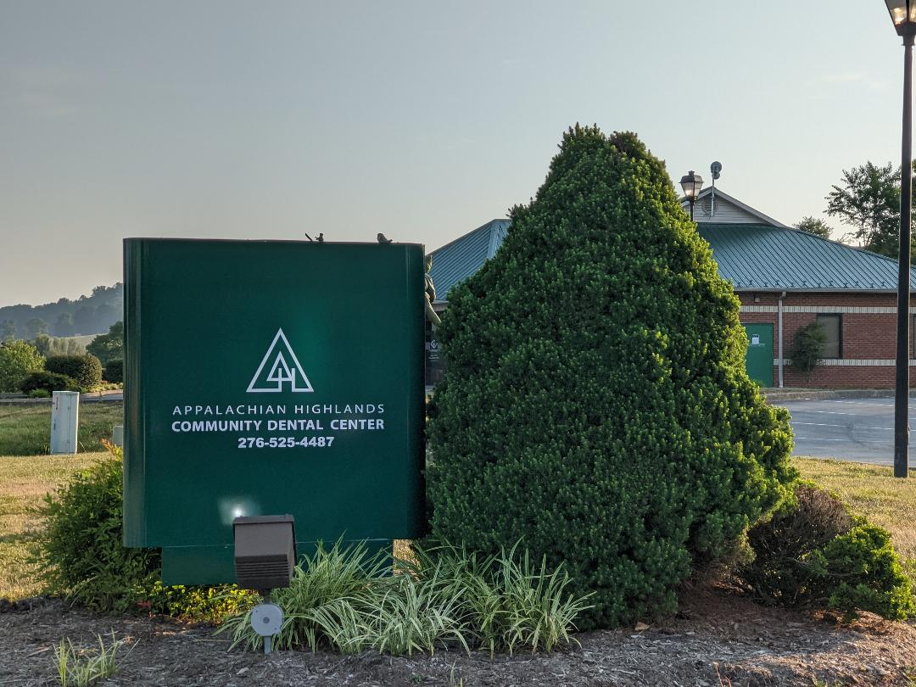
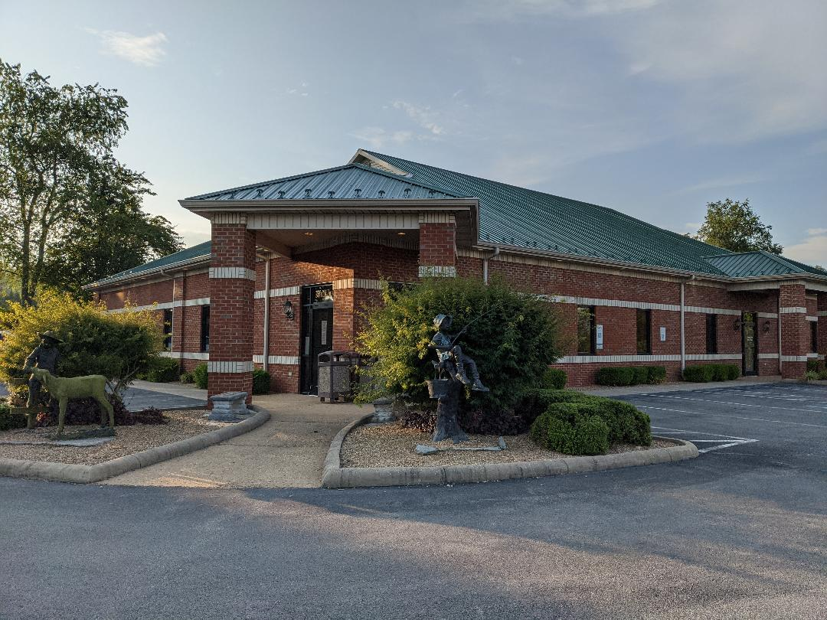
616 Campus Drive Suite #100
Abingdon, VA 24210

Slide 25
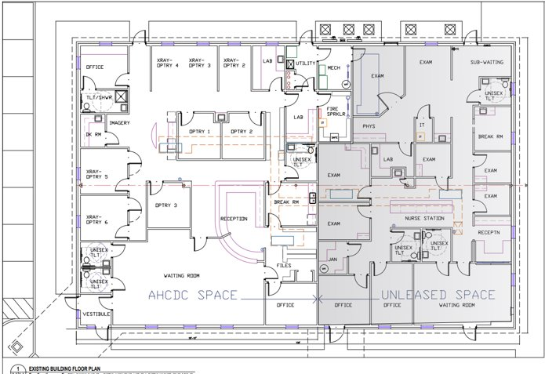

Slide 26
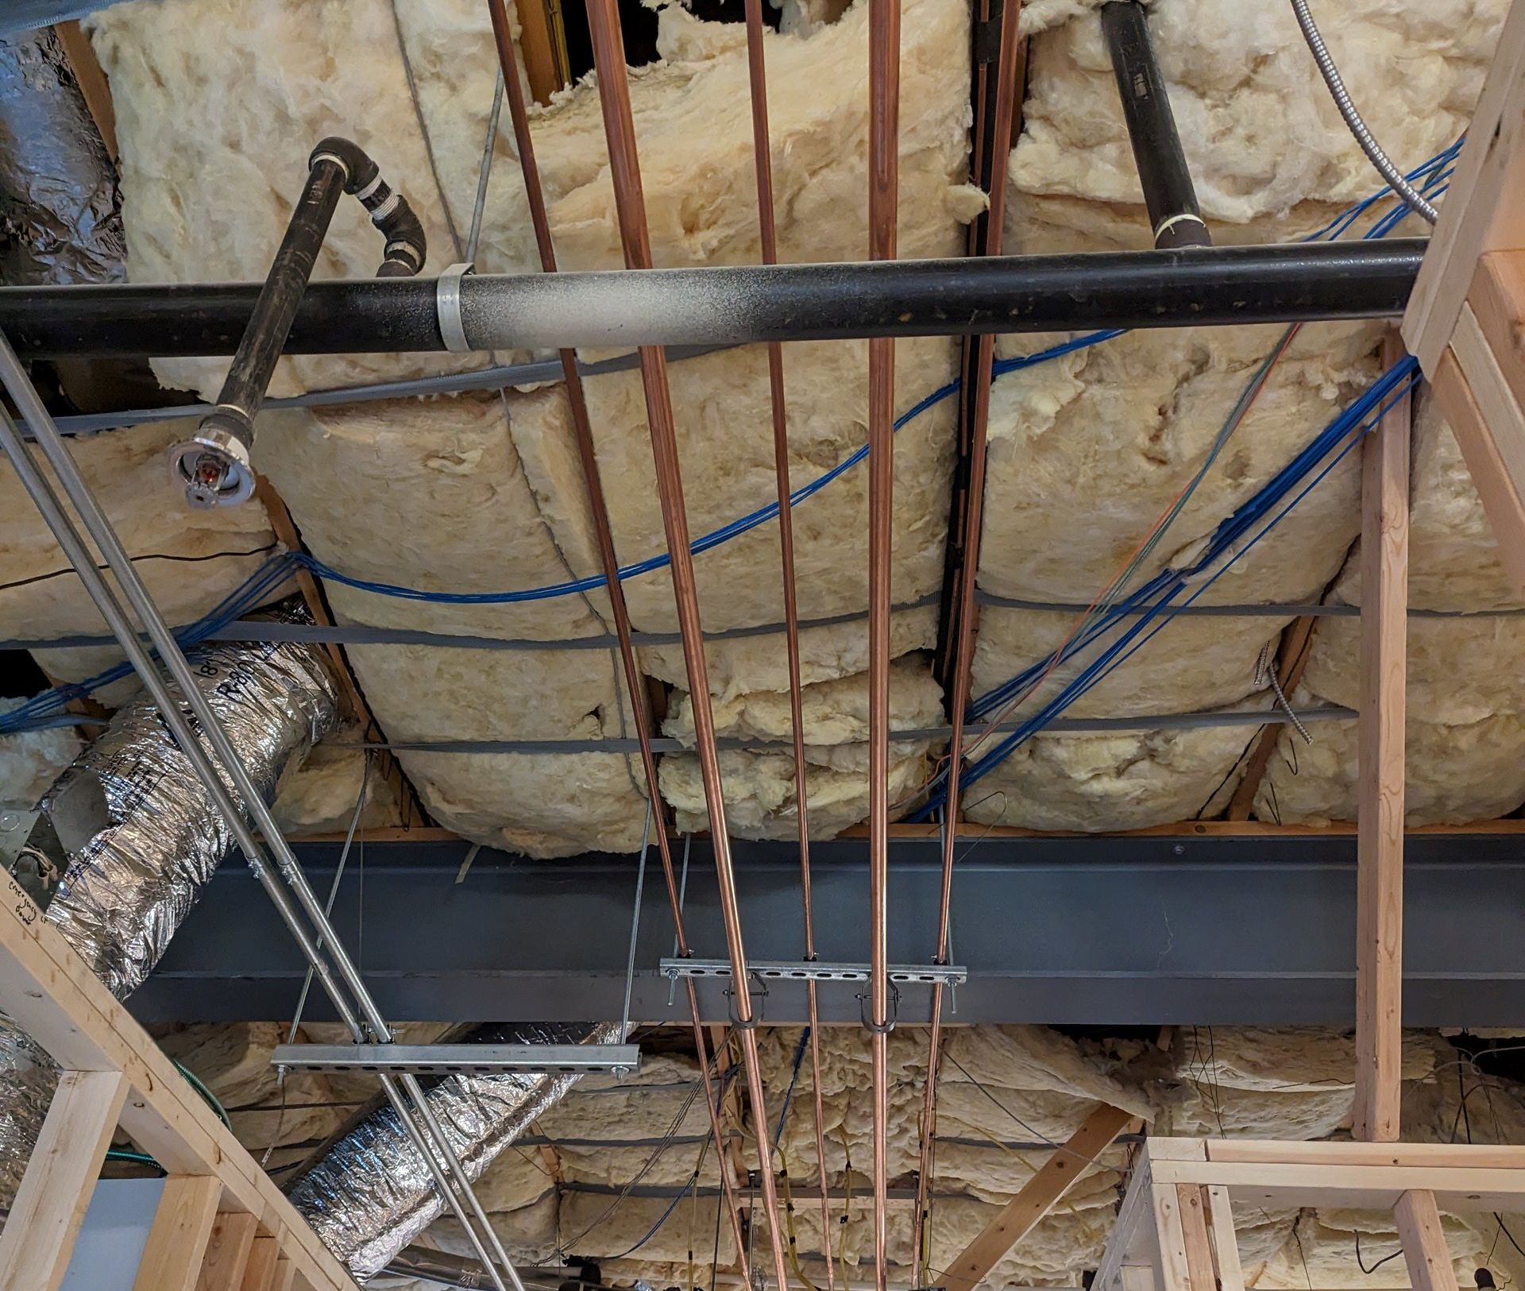
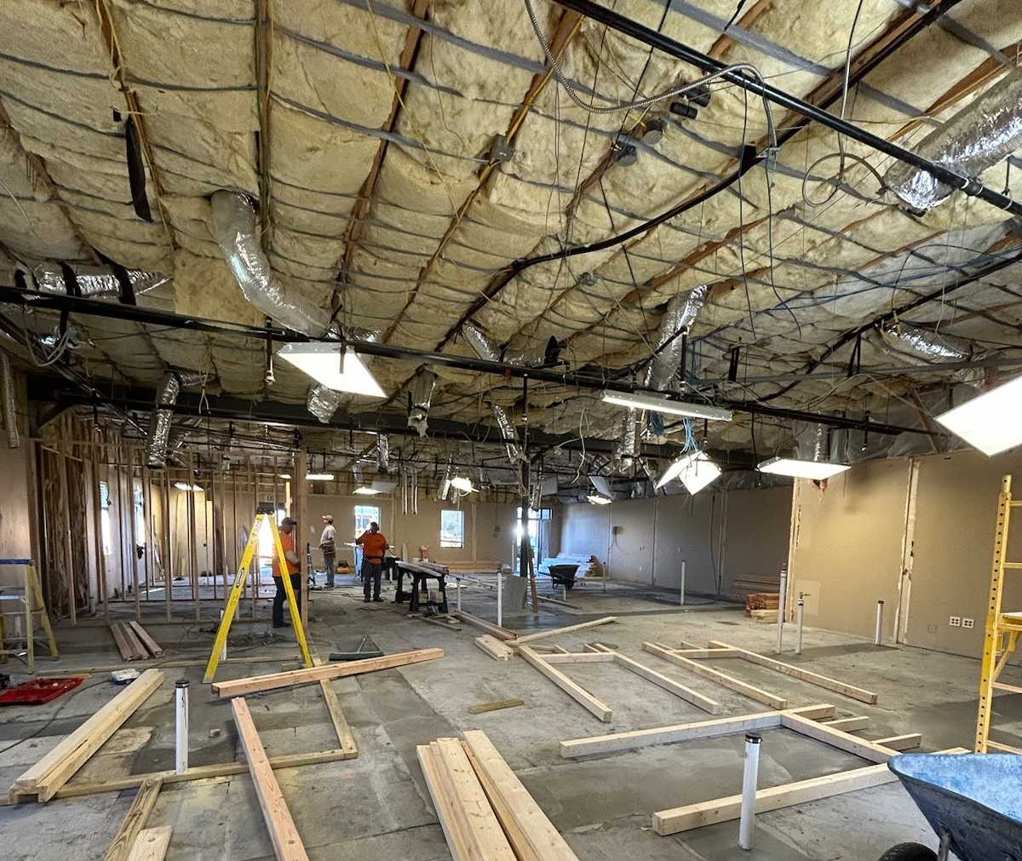
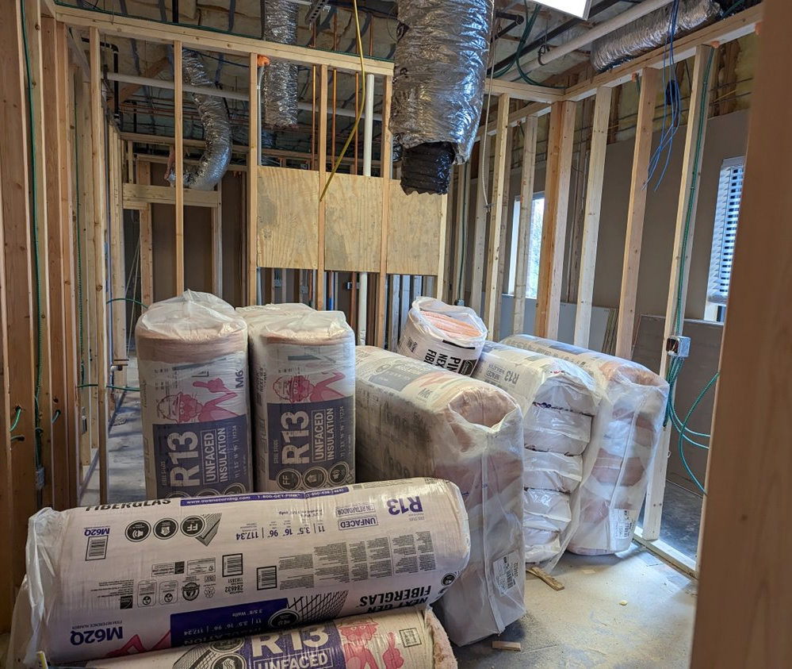
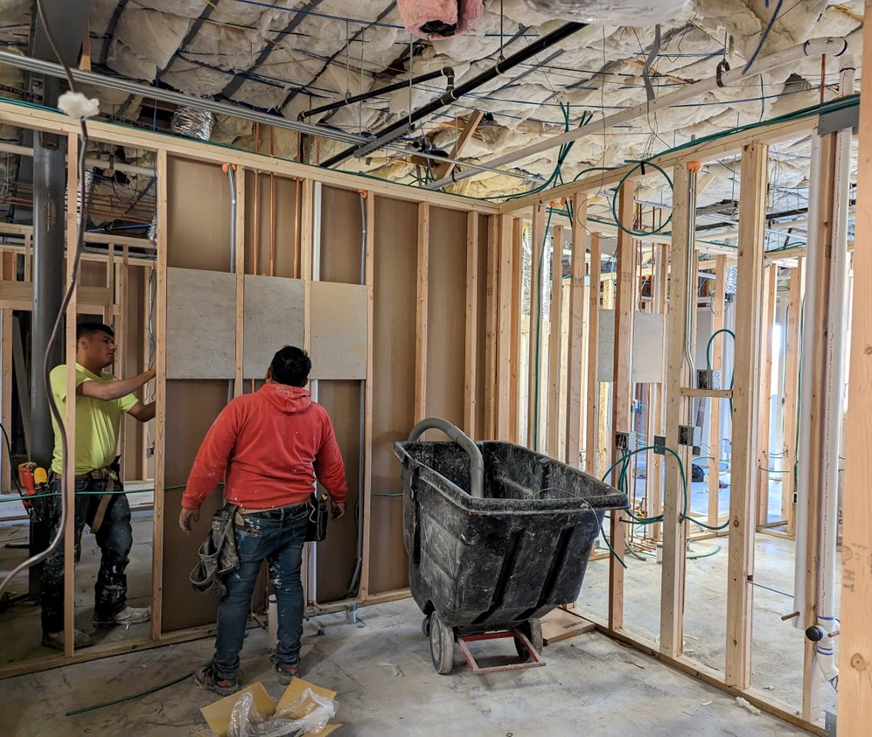
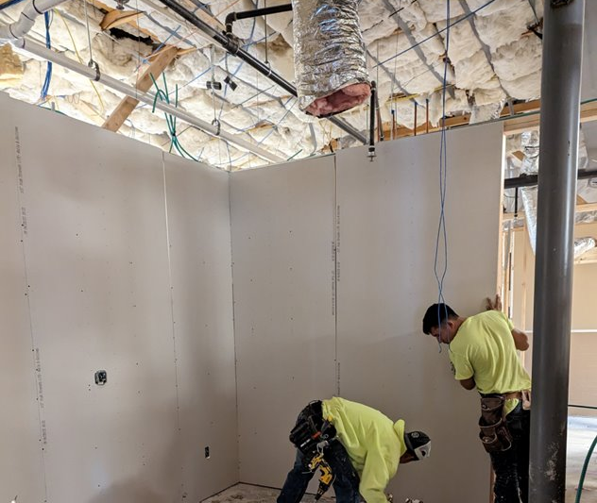
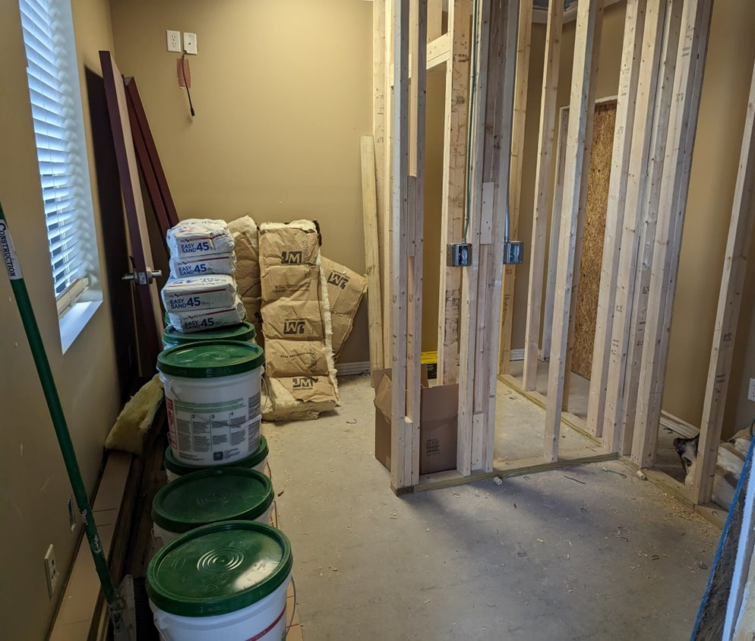

Slide 27
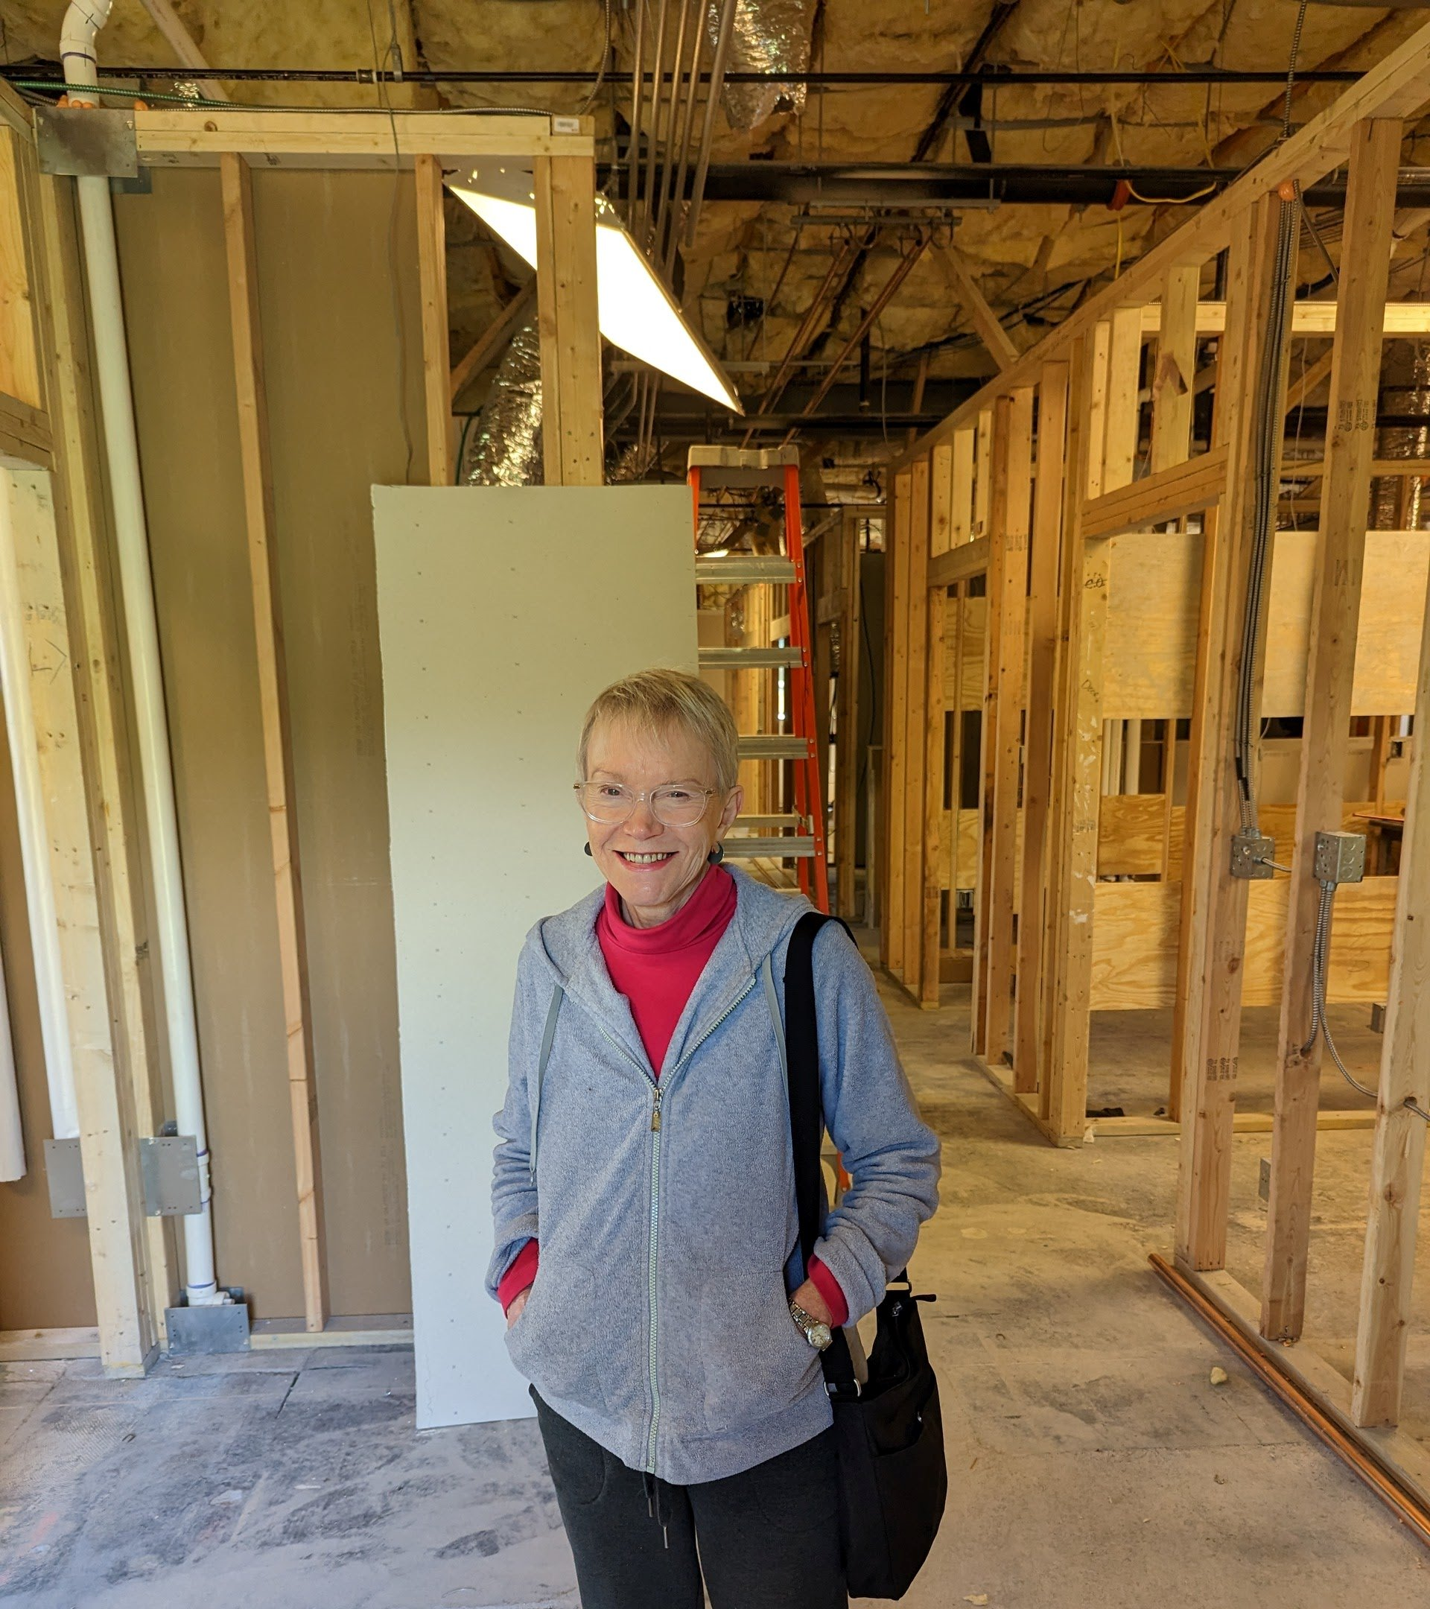
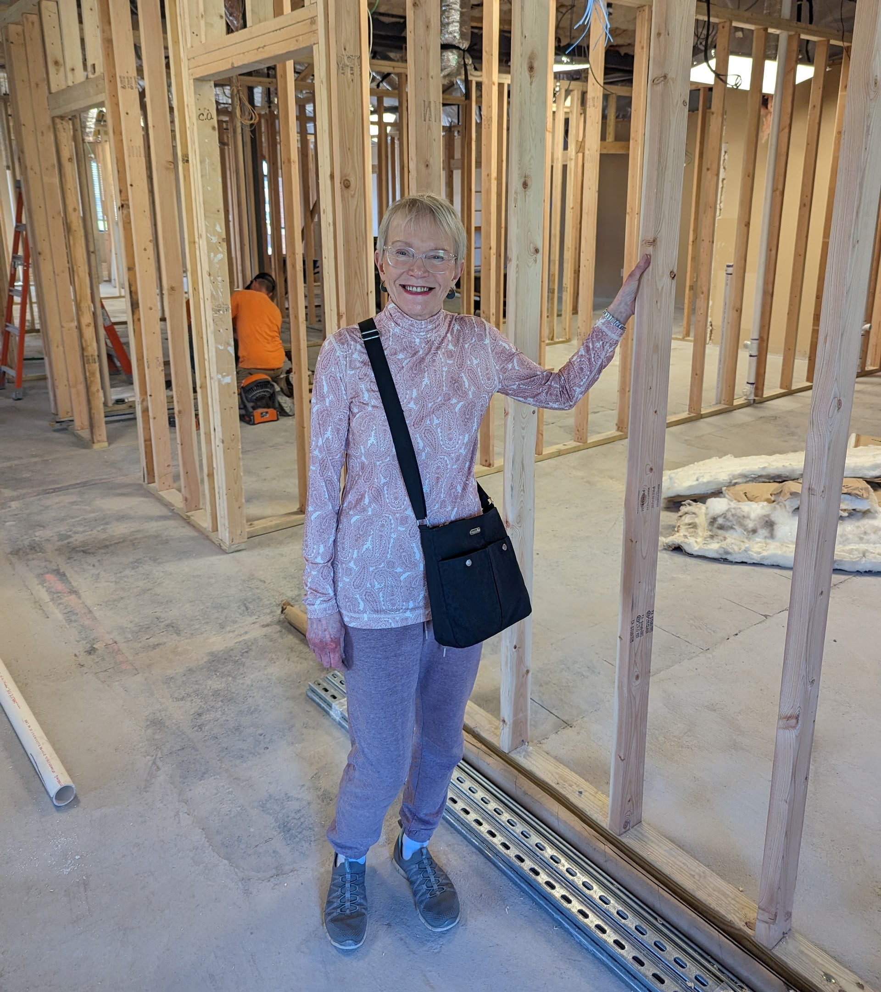

Slide 28
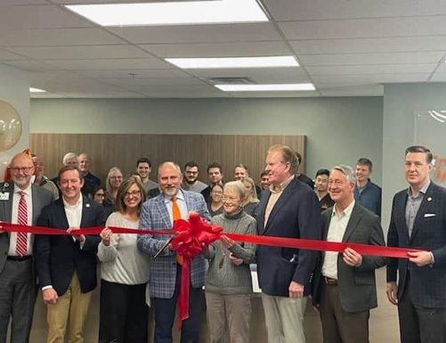
EXPANSION COMPLETED
Ribbon Cutting – December 15, 2023
Floor Plan
Funding
Partnerships

Slide 29
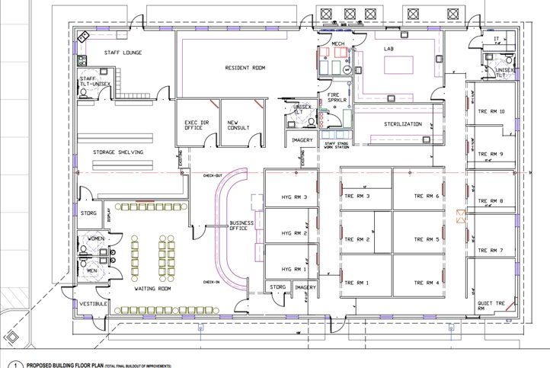

Slide 30
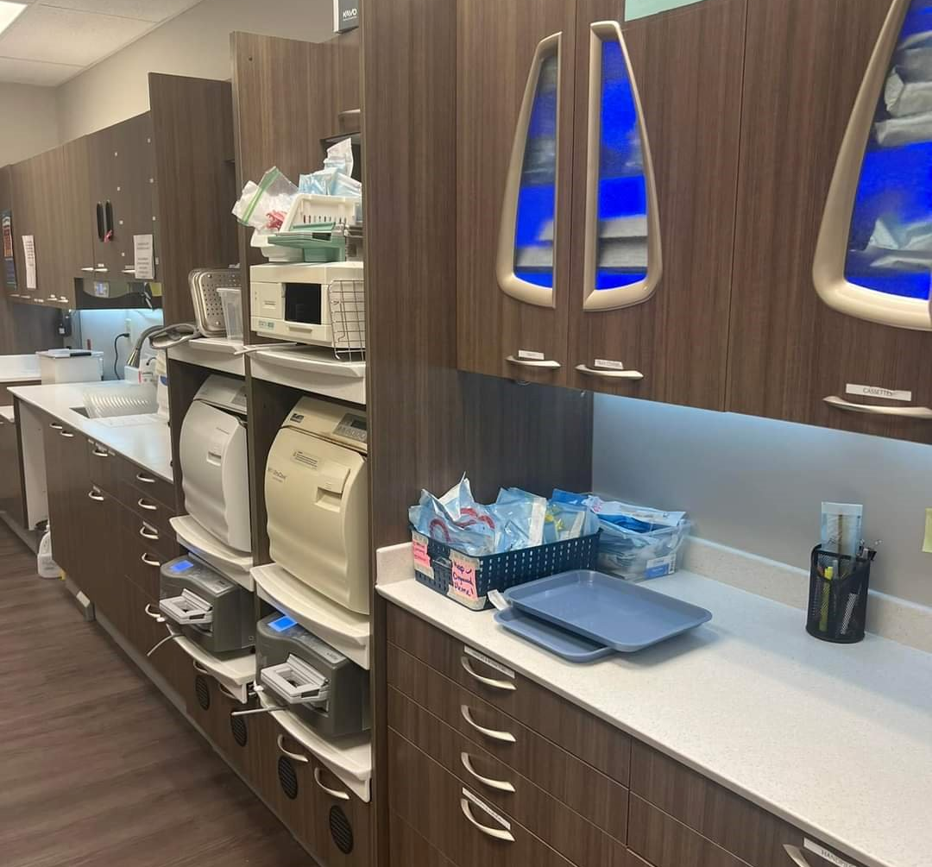
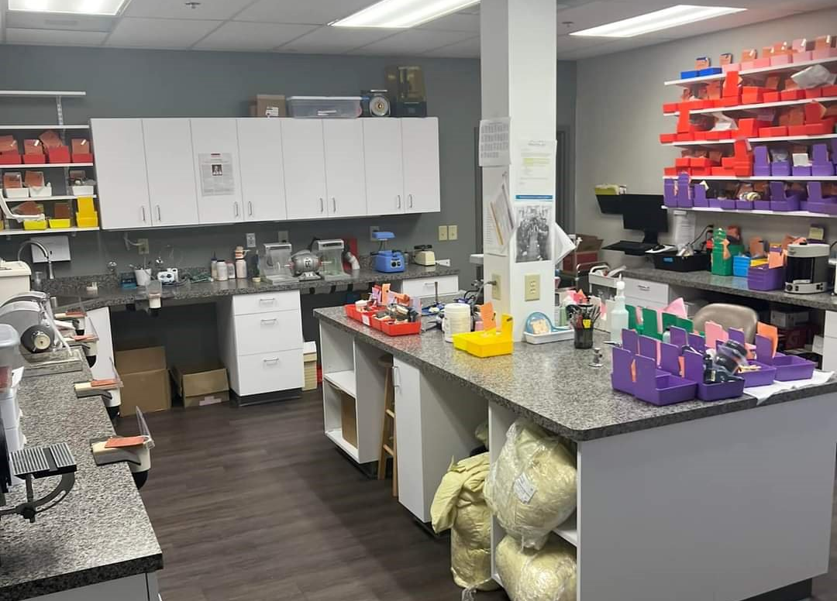
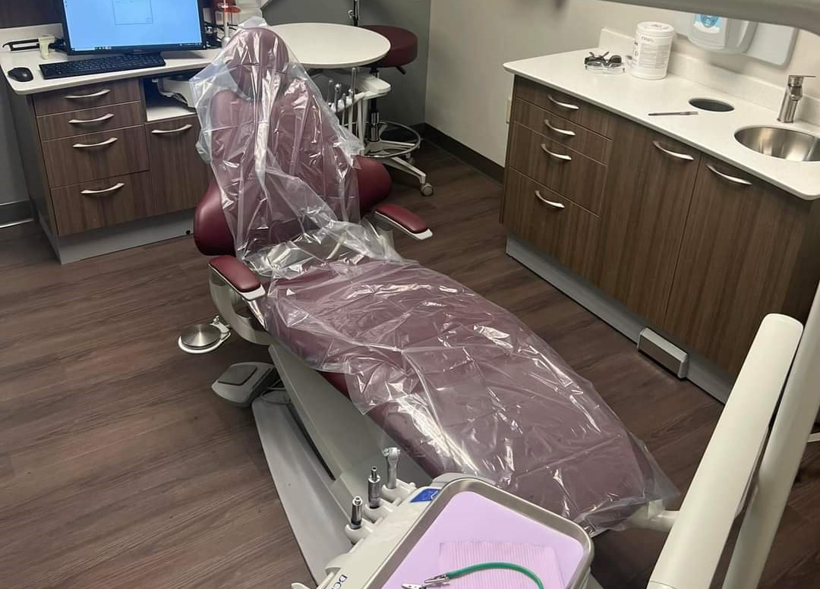

Slide 31
AHCDC Lab
AHCDC, has spent $288,822.39 in dental lab fees only, through September 2024. Note: lab fees increase as residents seat and treat faster and do more dental prostheses. Annual costs could be up to $350K+. Towards the end of their residency, more labs are delivered, thus raising dental lab expenses.
Goal is to outsource as few dental labs as possible and upskilling residents, assistants and lab staff.
Initially, the goal is to begin with crowns and dentures (2740, 5110, and 5120)
AHCDC would be interested in piloting a Medicaid Lab Hub for safety net clinics facing the same financial burdens

Slide 32
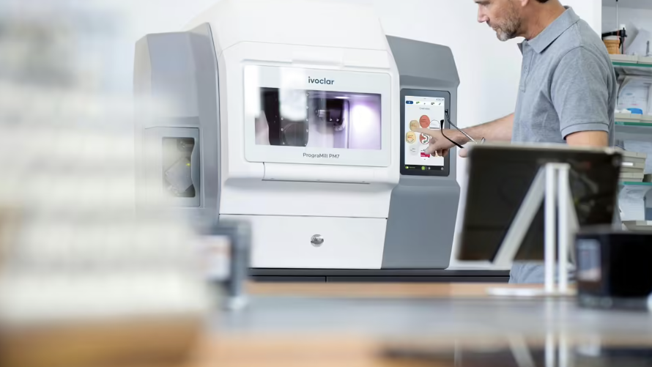
Ivoclar PrograMill PM7 (Source: ivoclar.com)

Slide 33
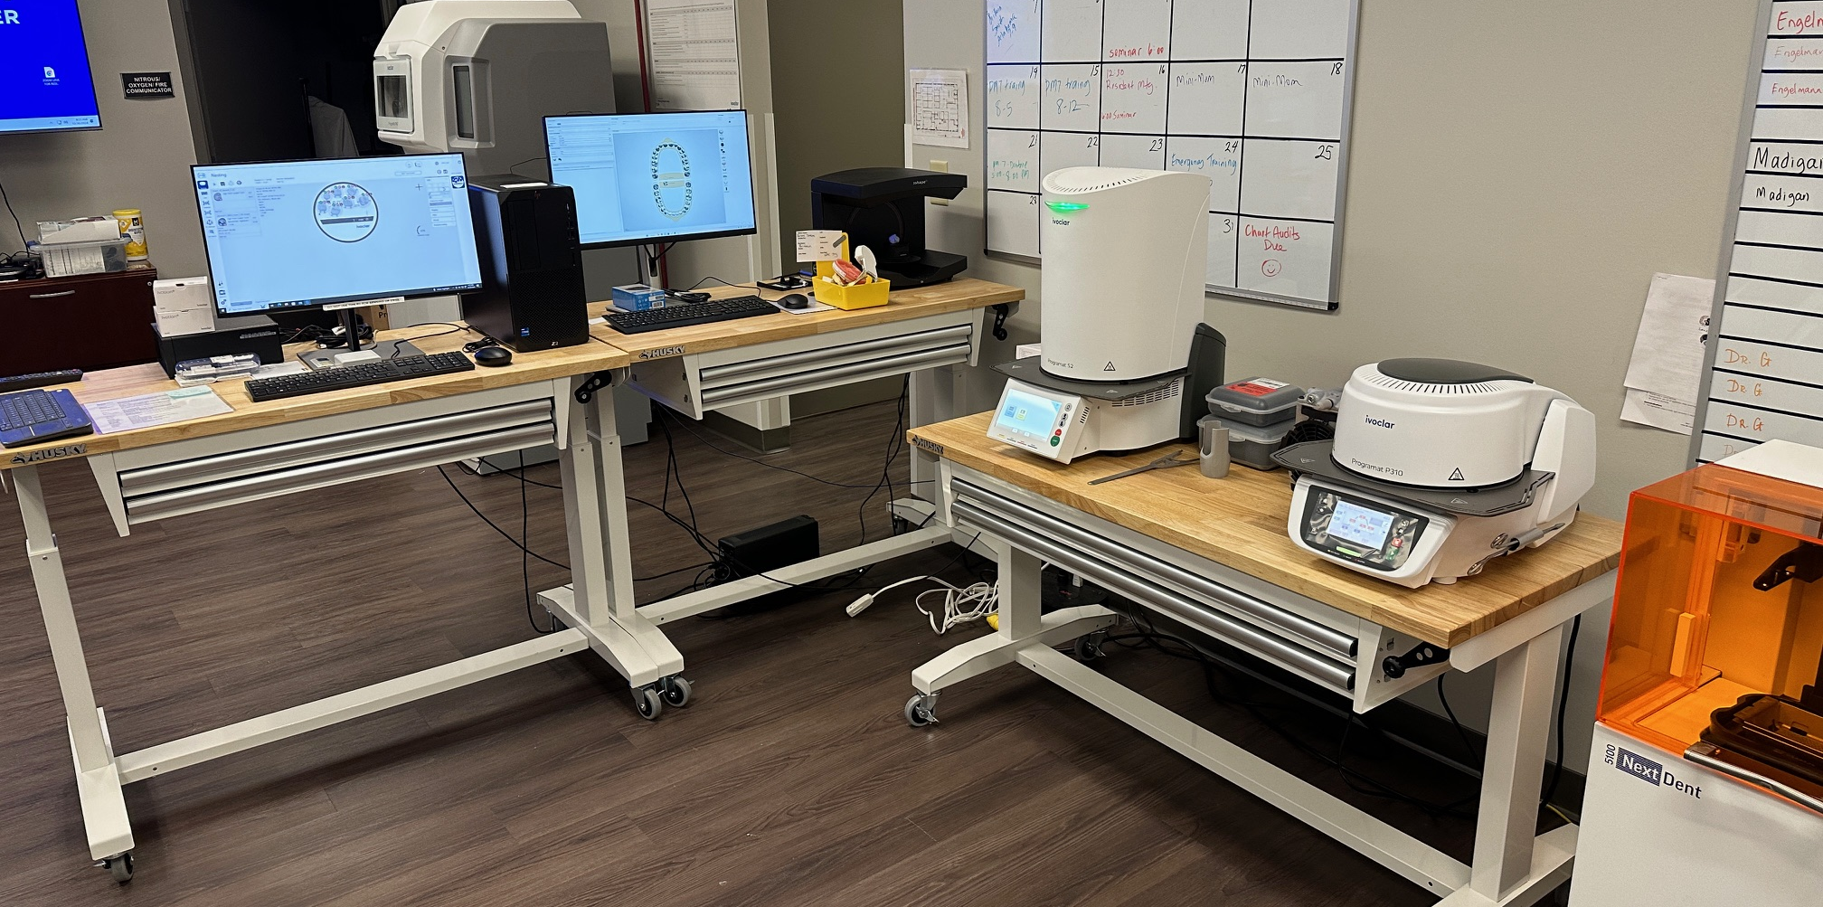

Slide 34
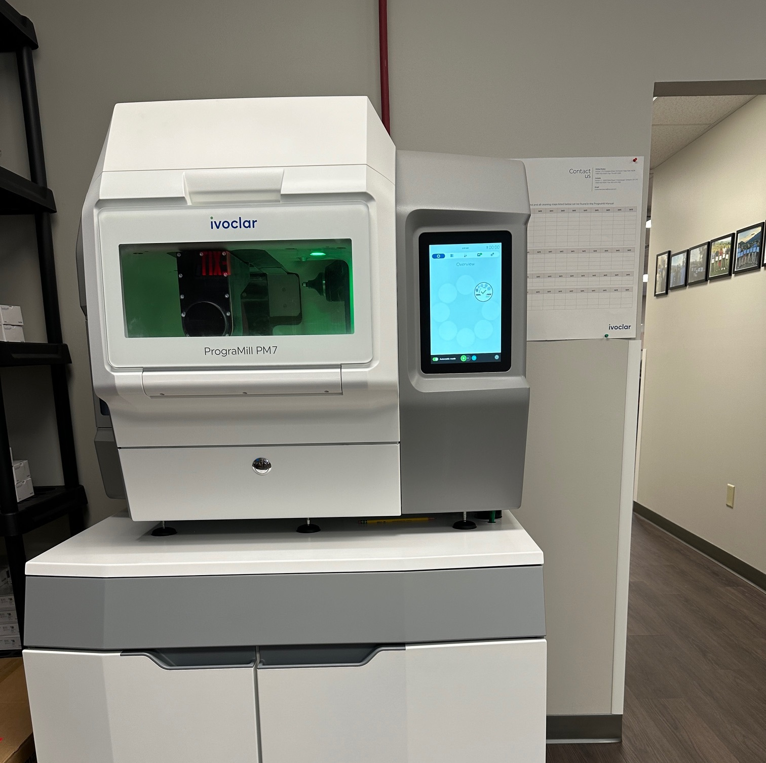
Ivoclar PrograMill
PM7
+ 3Shape
= Patients Served
Step 1: Focus on design (chairside and office design station)
Step 2: Focus on ADA – D2740 (crown)
Step 3: Focus on ADA – D5110, D5120 (denture arches)
Step 4: Over 1,200 patients are on a new patient wait list and 256 patients need at least one arch (~490 arches are needed)

Slide 35
Medicaid Provider Only Lab Concept
Providers that are Medicaid Providers can only utilize AHCDL for reduced lab fees.

Slide 36
Medicaid Provider Only Lab Concept
Background:

Slide 38
Key Information
There were 7,607 licensed dentists in Virginia in 2022.
There were 6,390 licensed dental hygienists in Virginia in 2022.
There are 49 registered dental assistants IIs (DAIIs) practicing in Virginia.
Only 27% of practicing dentists treat Virginians enrolled in Medicaid or Family Access to Medical Insurance Security (FAMIS), public insurance programs for people who have low incomes or disabilities.
Thirteen Virginia localities have fewer than one FTE dentist, including eight localities that have no FTE dentists.
Nine Virginia localities have fewer than one FTE dental hygienist, including five localities that have no FTE dental hygienists.
103 of Virginia’s 133 localities are designated either a dental geographic Health Professional Shortage Area (HPSA) or are home to a dental population or facility HPSA.

Slide 39
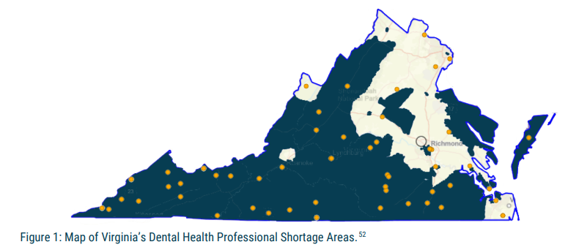
Key Information
There is roughly only one full-time dentist per 5,000 Virginians in many localities. In contrast, there are roughly three full-time dentists per 5,000 Virginians in Northern Virginia

Slide 40
Key Information

Slide 41
Key Information

Slide 42
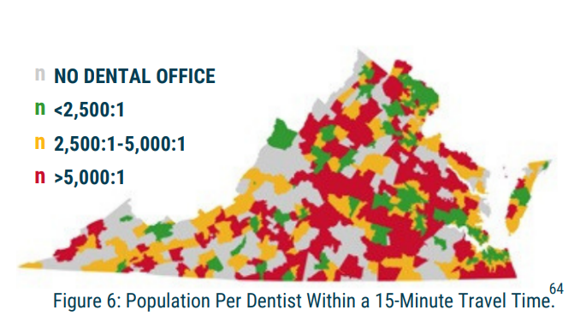
Key Information

Slide 43
Key Information
Over 2 million Virginian children and adults are insured through Medicaid
ONLY 27% OF VIRGINIA’S DENTISTS TREATED MEDICAID MEMBERS IN 2022
There are insufficient training opportunities for Virginia’s current and future oral health professionals. There is only one dental school in Virginia. There are six dental hygiene programs, but only two are located in the western part of the state. There is only one Dental Laboratory Technician Training Program in NOVA.

Slide 44
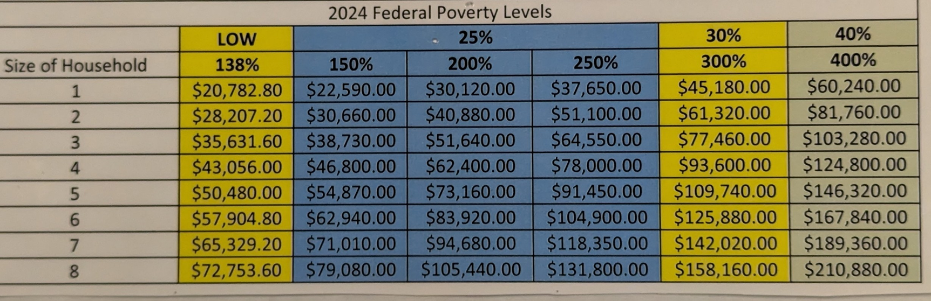
Cardinal Smiles Reported
30,178 Adult visits in 2024 All Clinics
11,511 Adult visits at AHCDC in 2024
Since inception in 2020 = 32,193 visits
83% of all patients are VA Medicaid at AHCDC

Slide 45
Medicaid Provider Only Lab Concept
Providers that only accept Medicaid can utilize AHCDL for reduced lab fees.
Lab services will include the following Codes:
D2740 single unit crowns
D5110 Maxillary Denture
D5120 Mandibular Denture
Better Profit margins with reduced fees could make being a Medicaid provider more appealing.
How?

Slide 46

Capital Project 1 – Lab Renovation
2,500 square feet
Built to house six (6) future PM7 mills
Includes more space for a digital lab
Current wait list has over 256 individuals in need of dentures alone

Slide 48



Slide 49


Slide 51

Capital Project 2 – 7 Added Operatories
1,665 square feet
Addition of 7 new dental operatories
Addition of 1 large oral surgery room
Addition of sterilization
Goals for adding operatories
  Room for one additional resident
  Additional rooms to treat patients on a wait list (over 1,200)
  Space for faculty practice to elevate residents with 1-on-1 work with faculty
  Space to deliver labs that we will be able to produce faster
  Continue our mission to help those in need with access.

Slide 52
We Appreciate Everything Each of You Do for Dentistry and AHCDC!
Scottie R. Miller, DDS scottmiller@bvu.net
Cell #: (423) 383-1258

